Slide 1

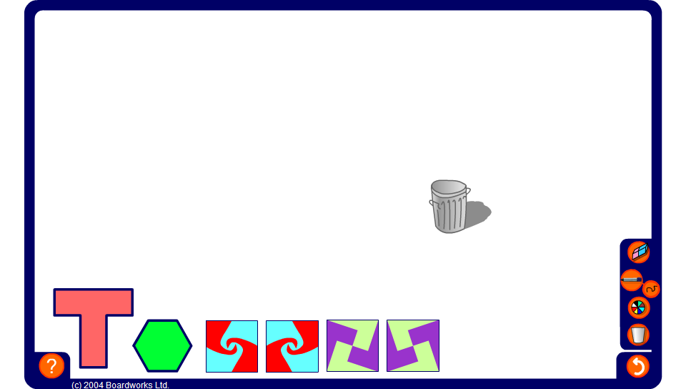


Investigating tiling patterns
Notes:
Investigate how many different tiling patterns can by produced using the given tile set.
Explore the symmetry properties for each pattern by asking how many lines of symmetry each one has and also for the order of rotational symmetry.
Link:
S4 Coordinates and transformations 1 – reflection symmetry and rotation symmetry.

